Slide 1

HireRight
Welcome to University of Maryland, Baltimore!
Please be advised that some items may change. Please contact HR for further guidance.

Slide 2
Obj. Completing tasks & attaching documents
Identify the steps to complete follow-up tasks for Hire Right through the Applicant Center
Show how to attach documents using a smart phone
Identify “HireRight” and “University of Maryland, Baltimore” for Document Requests
Demonstrate how to attach another file
Please be advised that some items may change. Please contact HR for further guidance.

Slide 3
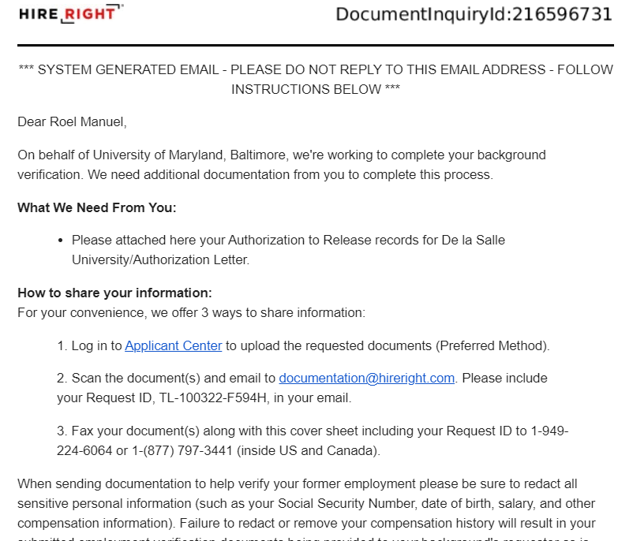
Reference #
Complete the Task
Remember Your Password
Please be advised that some items may change. Please contact HR for further guidance.

Slide 4
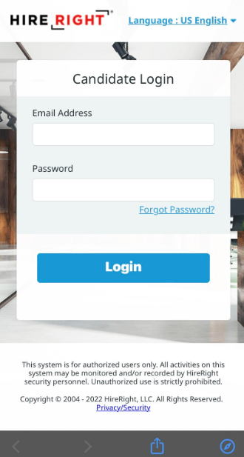
Type the Registered Email
Type the Correct Password
Please be advised that some items may change. Please contact HR for further guidance.

Slide 5
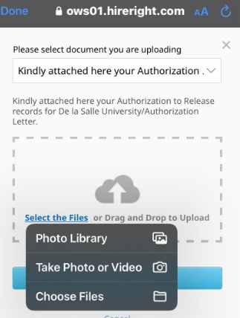
Click “Select the Files”
Choose the Action
Please be advised that some items may change. Please contact HR for further guidance.

Slide 6
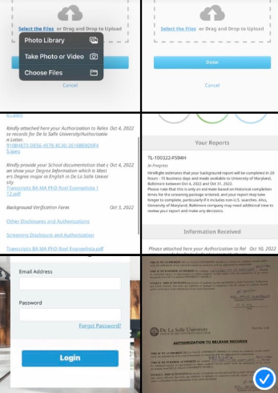
Choose the Image that you need to attach
Please be advised that some items may change. Please contact HR for further guidance.

Slide 7
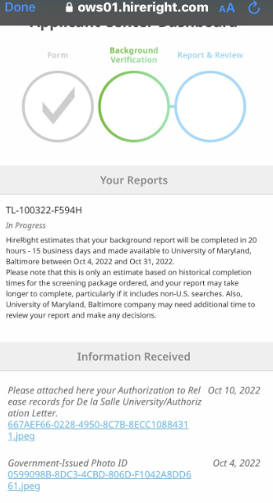
Signifies a Submission
Review Attached File
Please be advised that some items may change. Please contact HR for further guidance.

Slide 8
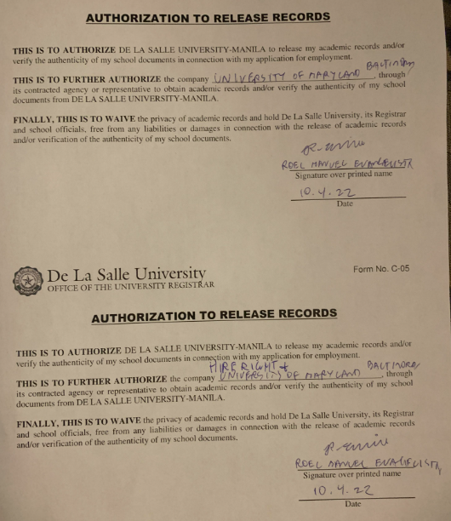
Write “University of Maryland Baltimore”
Sign with Pen
Write “Hire Right”
Please be advised that some items may change. Please contact HR for further guidance.

Slide 9
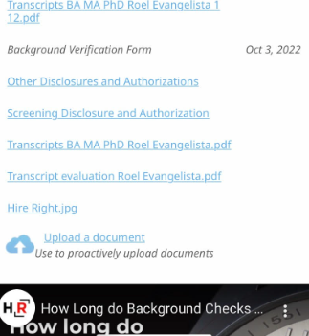
Click “Upload a Document”
Please be advised that some items may change. Please contact HR for further guidance.

Slide 10
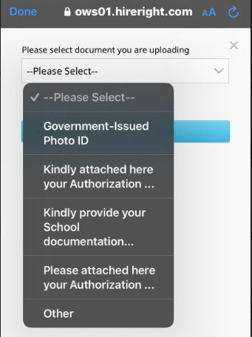
Click the Dropdown button
Select what is most appropriate
Please be advised that some items may change. Please contact HR for further guidance.

Slide 11
Thank you!
Hope this was helpful!
Please be advised that some items may change. Please contact HR for further guidance.

